Slide 1
Aggregation
Dr. Yashvardhan Sharma
Computer Science Department
BITS, Pilani
L13

Slide 2
Aggregation
The single most dramatic way to affect performance in a large data warehouse is to provide a proper set of aggregate (summary) records ... in some cases speeding queries by a factor of 100 or even 1,000.
No other means exist to harvest such spectacular gains."
- Ralph kimball

Slide 3
Consider the following questions!
How much total business did my newly remodelled stores do compared with the chain average?
• How did leather goods items costing less than $5 do with my most frequent shoppers?
• What was the ratio of non-holiday weekend days total revenue to holiday weekend days?

Slide 4
Aggregation
Aggregations can be created on-the-fly or by the process of pre-aggregation
An aggregate is a fact table record representing a summarization of base-level fact table records
– Category-level product aggregates by store by day
– District-level store aggregates by product by day
– Monthly sales aggregates by product by store
– Category-level product aggregates by store district by day
– Category-level product aggregates by store district by month

Slide 5
Aggregation
Still aggregations is so underused. Why?
We are still not comfortable with redundancy!
Requires extra space
Most of us are not sure of what aggregates to store
A bizarre phenomena called
SPARSITY FAILURE

Slide 6
Aggregates & Indexes
Analogous??
Indexes duplicate the information content of indexed columns
We don’t disparage this duplication as redundancy because of the benefits
Aggregates duplicate the information content of aggregated columns
Traditional indexes very quickly retrieve a small no. of qualifying records in OLTP systems
In DW, queries require millions of records to be summarized
Bypassing indexes and performing table scans

Slide 7
Aggregates
Need new indexes that can quickly and “logically” get us to millions of records
Logically because we need only the summarized result and not the individual records
Aggregates as Summary Indexes!

Slide 8
Aggregates
Aggregates belong to the same DB as the low level atomic data that is indexed (unlike data marts)
Queries should always target the atomic data
Aggregate Navigation automatically rewrites queries to access the best presently available aggregates
Aggregate navigation is a form of query optimization
Should be offered by DB query optimizers
Intelligent Middleware

Slide 9
Aggregation: Thumb Rule
The size of the database should not become more than double of its original size

Slide 10
Aggregates: Trade-Offs
Query performance vs. Costs
Costs
Storing
Building
Maintaining
Administrating
Imbalance: Retail DW that collapsed under the weight of more that 2500 aggregates and that took more than 24 hours to refresh!!!

Slide 11
Aggregates: Guidelines
Set an aggregate storage limit (not more than double the original size of the DB)
Dynamic portfolio of aggregates that change with changing demands
Define small aggregates: 10 to 20 times smaller than the FT or aggregate on which it is based
Monthly product sales aggregate: How many times smaller than daily product sales table?
If your answer is 30…you are forgiven, but you are likely to be wrong
Reason: Sparstiy Failure

Slide 12
Aggregates: Guidelines
Spread aggregates: Goal should be to accelerate a broad spectrum of queries

Slide 13
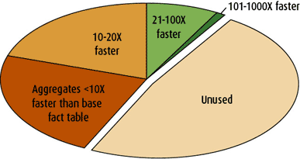
Aggregates: Guidelines
Spread aggregates: Goal should be to accelerate a broad spectrum of queries
Figure 1 Poor use of the space allocated for aggregates.

Slide 14
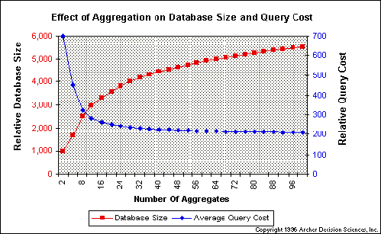
Aggregation
Figure taken from Neil Raden article (www.hiredbrains.com/artic9.html)

Slide 15
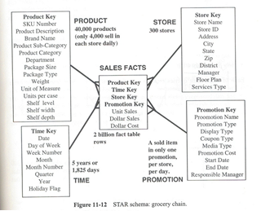
Star Schema: Grocery Store

Slide 16
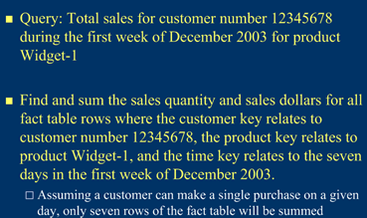
Some Queries

Slide 17
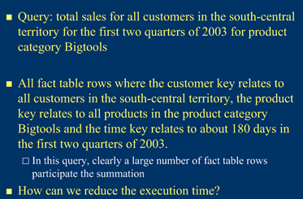
Some Queries

Slide 18
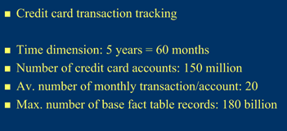
Fact Table Size

Slide 19
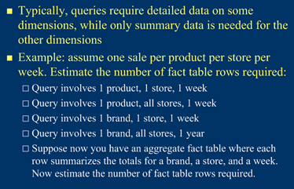
Aggregating Fact Tables

Slide 20
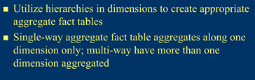
Multi-way Aggregates

Slide 21
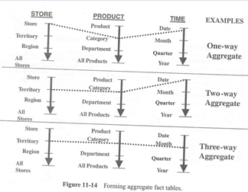
Multi-way Aggregates

Slide 22
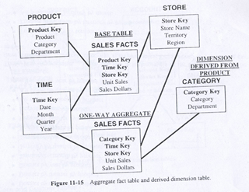
Multi-way Aggregates

Slide 23
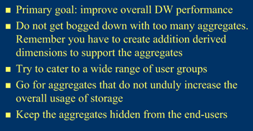
Goals of Aggregation

Slide 24
Aggregation
Aggregations can be created on-the-fly or by the process of pre-aggregation
An aggregate is a fact table record representing a summarisation of base-level fact table records
– Category-level product aggregates by store by day
– District-level store aggregates by product by day
– Monthly sales aggregates by product by store
– Category-level product aggregates by store district
by day
– Category-level product aggregates by store district
by month

Slide 25
Aggregates
Issues
Which aggregates to create?
How to guard against sparsity failure?
How to store them?
New Fact Table approach
New Level Field approach
How queries are directed to appropriate aggregates?

Slide 26
Aggregates: Example
Grocery Store
3 dimensions – Product, Location, & Time
10000 products
1000 stores
100 time periods
10% Sparsity
Total no. of records =
100 million

Slide 27
Aggregates: Example
Hierarchies
10000 products in 2000 categories
1000 stores in 100 districts
30 aggregates in 100 time periods

Slide 28
Aggregates: Example
How many aggregates are possible?
1-way: Category by Store by Day
1-way: Product by District by Day
1-way: Product by Store by Month
2-way: Category by District by Day
2-way: Category by Store by Month
2-way: Product by District by Month
3-way: Category by District by Month

Slide 29
Aggregates: Example
What is Sparsity?
Fact tables are sparse in their keys!
10% sparsity at base level means that only 10% of the products are sold on any given day (average)
As we move from base level to 1-way the sparsity _ _ _ _ _ _ _ _
What affect sparsity will have on the size of the aggregate fact table?
Increases!

Slide 30
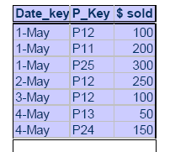
Sparsity Failure
The planning of aggregate table sizes can be tricky because of the phenomenon called sparsity failure
This phenomenon appears when we build aggregates on sparse tables.
For example: In the grocery store item movement database, only about 10% of the products in the store are actually sold in a given store on a given day. Even disregarding the promotion dimension, the database is only occupied 10% in the primary keys of product, store, and time. However when we build aggregates, the occupancy rate shoots up dramatically.

Slide 31
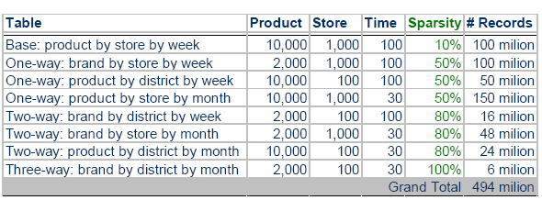
Sparsity Failure
Assume we have:
10,000 products within 2,000 different brands
1,000 stores within 100 districts
100 weeks within 30 months

Slide 32
Aggregates: Example
Let us assume that sparsity for 1-way aggregates is 50%
For 2-way 80%
For 3-way 100%
Do you agree with this?
Is it logical?

Slide 33
Aggregates: Example
Table | Prod. | Store | Time | Sparsity | # Records
Base | 10000 | 1000 | 100 | 10% | 100 million
1-way | 2000 | 1000 | 100 | 50% | 100 million
1-way | 10000 | 100 | 100 | 50% | 50 million
1-way | 10000 | 1000 | 30 | 50% | 150 million
2-way | 2000 | 100 | 100 | 80% | 16 million
2-way | 2000 | 1000 | 30 | 80% | 48 million
2-way | 10000 | 100 | 30 | 80% | 24 million
3-way | 2000 | 100 | 30 | 100% | 6 million
 |  |  |  | Grand Total | 494 million

Slide 34
Aggregates: Example
An increase of almost 400%
Why it happened?
Look at the aggregates involving Location and Time!
How can we control this aggregate explosion?
Do the calculations again with 500 categories and 5 time aggregates

Slide 35
Aggregates: Example
Table | Prod. | Store | Time | Sparsity | # Records
Base | 10000 | 1000 | 100 | 10% | 100 million
1-way | 500 | 1000 | 100 | 50% | 25 million
1-way | 10000 | 100 | 100 | 50% | 50 million
1-way | 10000 | 1000 | 5 | 50% | 25 million
2-way | 500 | 100 | 100 | 80% | 4 million
2-way | 500 | 1000 | 5 | 80% | 2 million
2-way | 10000 | 100 | 5 | 80% | 4 million
3-way | 500 | 100 | 5 | 100% | 0.25 million
 |  |  |  | Grand Total | 210.25 million

Slide 36
Aggregate Design Principle
Each aggregate must summarize at least 10 and preferably 20 or more lower-level items

Slide 37
How to store aggregates?
as new Level fields in an already existing Fact table
as new fact tables

Slide 38
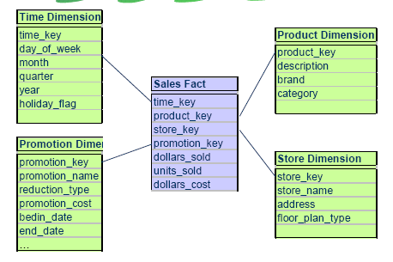
Example of a Dimensional Model

Slide 39
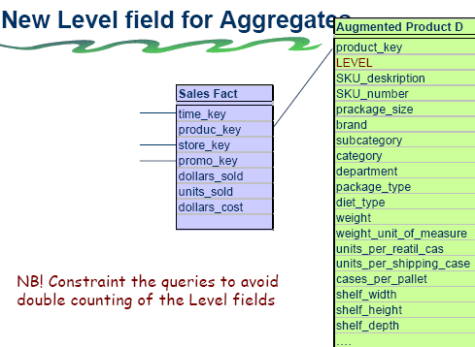

Slide 40
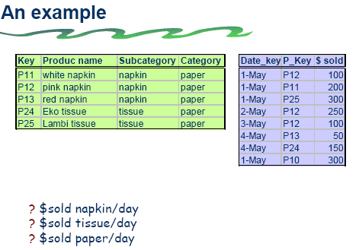

Slide 41
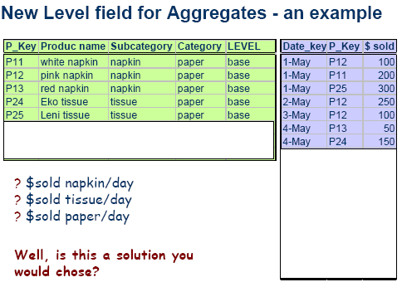

Slide 42
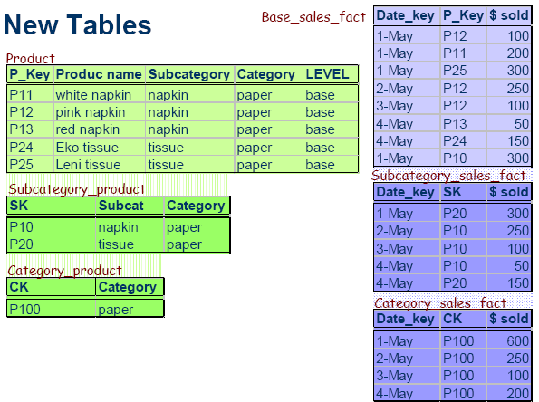

Slide 43
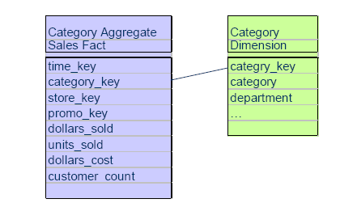
New Fact Tables for Aggregates
The creation of aggregate fact table requires the creation of:
a derivative dimension
an artificial key for each new derivative dimension

Slide 44
How to store aggregates
as new Level fields in an already existing Fact table
– problems with double count
– visible for the users
as new fact tables
+ no problems with double count
+ invisible for the users
+ are easily introduced and/or reduced at different
points in time
+ simpler metadata
+ simpler choice of key
+ the size of the field for the summarised data does
not increase the size of the field for the basic data

Slide 45
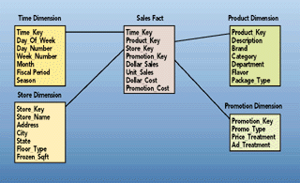
Aggregates

Slide 46
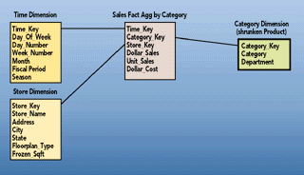
Aggregates: Shrunken Dimensions

Slide 47
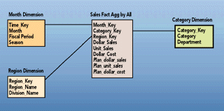
Aggregates: Shrunken Dimensions

Slide 48
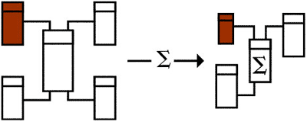
Aggregates: Shrunken Dimensions

Slide 49
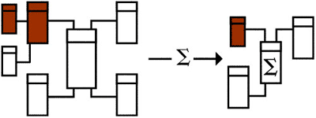
Aggregates: Shrunken Dimensions

Slide 50
Aggregate Navigator
How queries are directed to the appropriate aggregates?
Do end user query tools have to be “hardcoded” to take advantage of aggregates?
If DBA changed the aggregates all end user applications have to be recoded
How do we overcome this problem?

Slide 51
Aggregate Navigator
Aggregate Navigator (AN) is the solution
So what is an AN?
A middleware sitting between user queries and DBMS
With AN, user applications speak just base level SQL
AN uses metadata to transform base level SQL into “Aggregate Aware” SQL

Slide 52
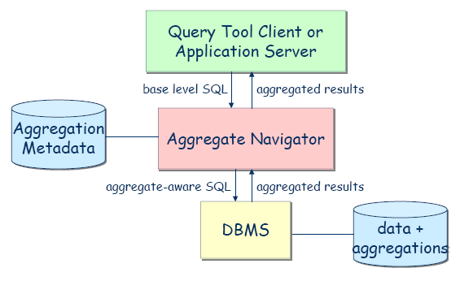
Aggregation Navigator

Slide 53
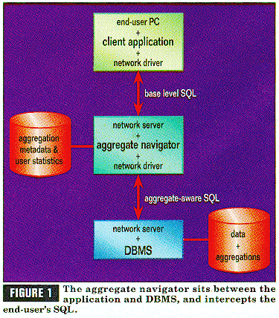

Slide 54
AN Algorithm
Rank Order all the aggregate fact tables from the smallest to the largest
For the smallest FT, look in associated DTs to verify that all the dimensional attributes of the current query can be found.If found, we are through. Replace the base-level FT with the aggregate fact and aggregate DTs
If step 2 fails, find the next smallest aggregate FT and try step 2 again. If we run out of aggregate FTs, then we must use base tables

Slide 55
Design Requirements
#1 Aggregates must be stored in their own fact tables, separate from the base-level data. In addition, each distinct aggregation level must occupy its own unique fact table
#2 The dimension tables attached to the aggregate fact tables must, wherever possible, be shrunken versions of the dimension tables associated with the base fact table.

Slide 56
Design Requirements
#3 The base Fact table and all of its related aggregate Fact tables must be associated together as a "family of schemas" so that the aggregate navigator knows which tables are related to one another.
#4 Force all SQL created by any end user or application to refer exclusively to the base fact table and its associated full-size dimension tables.

Slide 57
Storing Aggregates
New fact and dimension table approach (Approach 1)
New Level Field approach (Approach 2)
Both require same space?
Approach 1 is recommended
Reasons?

Slide 58
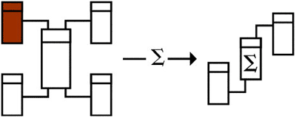
Lost Dimensions

Slide 59
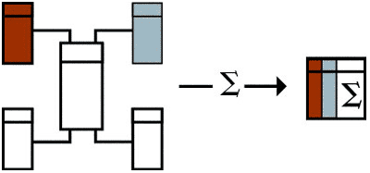
Collapsed Dimensions

Slide 60
Aggregations
Effective way to augment the performance of the data warehouse if you augment basic measurements with aggregate information
Aggregates speed queries by a factor of 100 or even 1000
The whole theory of dimensional modeling was born out of the need of storing multiple sets of aggregates at various grouping levels within the key dimensions
You can store aggregates right into fact tables in the Data Warehouse or (more appropriately) the Data Mart

